Slide 1
Chemical Engineering Thermodynamics 1
Julius C. Ahiekpor, PhD
Senior Lecturer
Chemical Engineering
juliusahiekpor@gmail.com

Slide 2
Course Content (Syllabus)
First law of thermodynamics; basic concepts: reversibility, equilibrium.
Volumetric properties of fluids
Second law of thermodynamics; Entropy.
Thermodynamic properties of fluids
Thermodynamic of flow processes and applications to fluids transportation equipment.
Conversion of heat into work by power cycles.
Refrigeration and liquefaction

Slide 3
Course Objective
To introduce students to the fundamental concepts of first and second law of thermodynamics
By the end of the course:
At the end of the course, the student should be able to:
1. Apply the first and second laws of thermodynamics and their implications.
2. Perform calculations on a process using thermodynamic principles.
Notes:
Ask students to write down their expectation of the course (30-45 minutes)

Slide 4
Expectation of students (Analysis of class input)
Understand and Apply
Understand and Pass
Interactive
Tutorial
Fairness

Slide 5
Recommended Reference Books
Smith JM, Van Ness HC, Abbot MM, (2004). Introduction to Chemical Engineering Thermodynamics, 7th edition, The Mcgraw-Hill Chemical Engineering Series
Moran MJ, Shapiro HN, et al., (2010). Fundamentals of Engineering Thermodynamics, 7th edition, Wiley
PK Nag (2008). Basic and Applied Thermodynamics, 8th Edition.

Slide 6
Grading
Assignments 10%
Mid-sem Exams 20%
Final Exam 70%

Slide 7
Introduction
Thermodynamics
????
Notes:
Ask students about thermodynamics

Slide 8
Thermodynamics is the branch of science which deals with energy as a property of matter and its transformation into heat and work.
It also deals with various properties of substances (volume, pressure, concentration, temperature,) and the changes in these properties due to energy transformations.
volume, pressure, concentration, temperature (STATE PROPERTIES)? We elaborate later..

Slide 9
Historical Perspective
Benjamin Thompson, in 1798, proposed a link between work and heat generated from observing the boring of cannons
Nicolas Carnot, in 1824, first proposed the concept of reversibility
James Joule (a brewmaster), between 1840-1849 measured rising temperature from mechanical stirring – quantifying the relation between work and heat
The term ‘thermodynamics’ was coined by Kelvin in 1849
The first thermodynamics book was written by Rankine

Slide 10
Where do we use thermodynamics
Used in day to day activities to describe the performance of propulsion systems, chemical reaction systems, power generation systems, and refrigerators, and to describe fluid flow, combustion, and many other phenomena.
It can address ANY geochemical reaction, if thermo says NO, rest assured the reaction will not proceed, if thermo says yes, then we can progress to the next question → how fast (Kinetics)

Slide 11
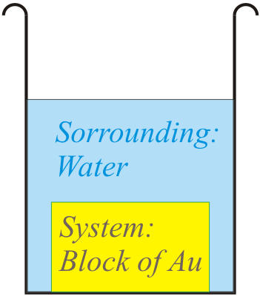
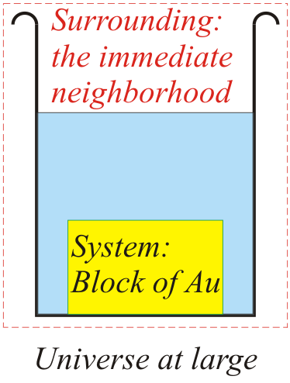
Basic Terminologies and definitions
To understand the laws of thermodynamics and how they work, first we need to get the terminology right. Some of the terms may look familiar (as they are used in everyday language as well)- but their meanings are more ‘technical’ and ‘precise’, when used in TD and hence we should not use them ‘casually’.
System is region where we focus our attention (Au block in figure).
Surrounding is the rest of the universe (the water bath at constant ‘temperature’).
Universe = System + Surrounding (the part that is within the dotted line box in the figure below)
More practically, we can consider the ‘Surrounding’ as the immediate neighbourhood of the system (the part of the universe at large, with which the system ‘effectively’ interacts). In this scheme of things we can visualize: a system, the surrounding and the universe at large.
In TD we usually do not worry about the universe at large!

Slide 12
Open, closed and isolated systems
To a thermodynamic system two ‘things’ may be added/removed: ➢ energy (heat, work) ➢ matter.
An open system is one to which you can add/remove matter (e.g. a open beaker to which we can add water). When you add matter- you also end up adding heat (which is contained in that matter).
A system to which you cannot add matter is called closed. Though you cannot add/remove matter to a closed system, you can still add/remove heat (you can cool a closed water bottle in fridge).
A system to which neither matter nor heat can be added/removed is called isolated. A closed vacuum ‘thermos’ flask can be considered as isolated.
Type of boundary | Interactions
Open | All interactions possible (Mass, Work, Heat)
Closed | Matter cannot enter or leave
Semi-permeable | Only certain species can enter or leave
Insulated | Heat cannot enter or leave
Rigid | Mechanical work cannot be done*
Isolated | No interactions are possible**
* By or on the system
** Mass, Heat or Work

Slide 13
Thermodynamic Properties
A property is a characteristic of a system and it is used to specify the condition or state of a system
Pressure, temperature, volume, mass
Extensive properties ?
depend on the size of the system and hence the mass of the system. Examples include mass, volume, and total energy.
Intensive properties ?
are independent of the size of the system. They include pressure and temperature.
A specific property (denoted by lower case letters) refers to an extensive property per unit mass. eg. v = V/m.

Slide 14
State postulate
The state of a system is described by its properties. In practice not all properties must be known before the state is specified. Once a sufficient number of properties are known, the state is specified and all other properties are determined.
The number of properties required to determine the state of a simple, homogeneous system is given by the state postulate:
“The thermodynamic state of a simple compressible system is completely specified by two independent, intensive properties”

Slide 15
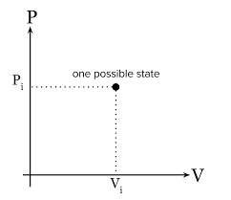
PV Diagram

Slide 16
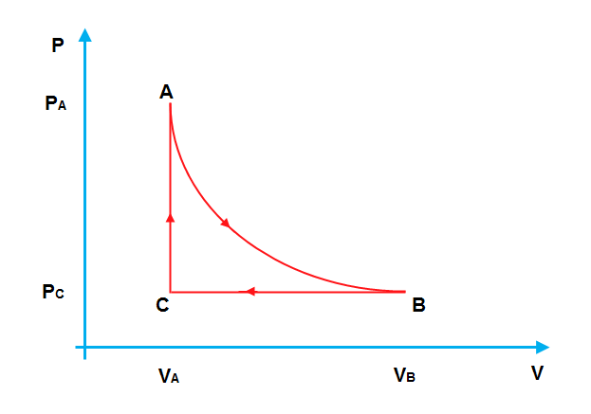
Thermodynamic process
Any change from one state to another is called a process. If the state of a system changes, then it is undergoing a process.
The succession of states through which the system passes defines the path of the process.

Slide 17
Processes in Thermodynamic
We will deal with some of them in detail later on….
Here is a brief listing of a few kinds of processes:
Isothermal process → the process takes place at constant temperature (e.g. freezing of water to ice at –10°C)
Isobaric → constant pressure (e.g. heating of water in open air→ under atmospheric pressure)
Isochoric (Isovolumetric)→ constant volume (e.g. heating of gas in a sealed metal container)
Reversible process → the system is close to equilibrium at all times (and infinitesimal alteration of the conditions can restore the universe (system + surrounding) to the original state.
Cyclic process → the final and initial state are the same. However, q and w need not be zero.
Adiabatic process → dq is zero during the process (no heat is added/removed to/from the system)
A combination of the above are also possible: e.g. ‘reversible adiabatic process’.

Slide 18
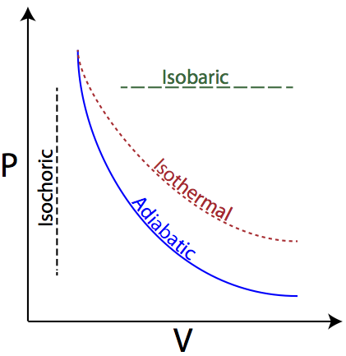
Processes illustrated on a PV diagram. We shall use this to perform some basic calculations using the first Law

Slide 19
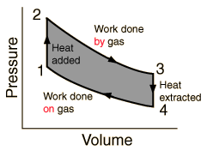
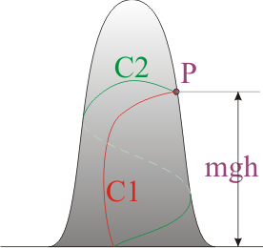
State and path functions
If the change in value of a function depends only on it’s initial and final states and not the path taken, the quantity is a state function. Eg. Internal energy
If the change in value is dependent on the path taken, then the function is path function. Eg. Work and heat

Slide 20
Equilibrium/ Reversibility
Anything at equilibrium is theoretically undergoing forward and reverse reactions:
A + B ↔ C
A + B → C AND C → A +B
Equilibrium has 2 criteria:
Reaction does not appreciably change in time
Perturbation of that equilibrium will result in a return to the equilibrium
Notes:
Discuss how K = k+/k- and how the forward and reverse rates are not necessarily the same, just that each is happening

Slide 21
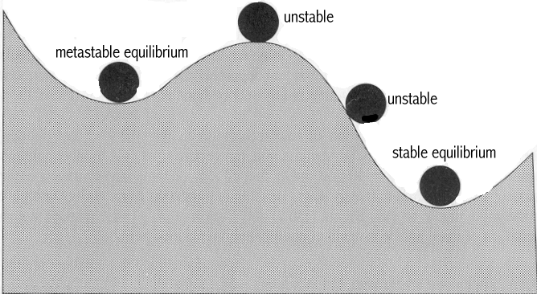
STABLE VS. METASTABLE EQUILIBRIUM
Stable equilibrium - System is at its lowest possible energy level.
Metastable equilibrium - System satisfies above two criteria, but is not at lowest possible energy.

Slide 22
Spontaneous and Driven processes
A spontaneous process is one which occurs ‘naturally’, ‘down-hill’ in energy*. I.e. the process does not require input of work in any form to take place. • Melting of ice at 50°C is a spontaneous process.
A driven process is one which wherein an external agent takes the system uphill in energy (usually by doing work on the system). • Freezing of water at 50°C is a driven process (you need a refrigerator, wherein electric current does work on the system).
Spontaneous process (Click to see)

Slide 23
Heat and Work
Work (W) in mechanics is displacement (d) against a resisting force (F). W = F × d
Work has units of energy (Joule, J).
Work can be expansion work (PΔV), electrical work, magnetic work etc. (many sets of stimuli and their responses).
Heat as used in TD is a tricky term. ➢ The transfer of energy as a result of a temperature difference is called heat. ➢ “In TD heat is NOT an entity or even a form of energy; heat is a mode of transfer of energy” [1]. ➢ “Heat is the transfer of energy by virtue of a temperature difference” [1]. ➢ “Heat is the name of a process, not the name of an entity” [1]. ➢ “Bodies contain internal energy (U) and not heat” [2].
The ‘flow’ of energy down a temperature gradient can be treated mathematically by considering heat as a mass-less fluid [1] → this does not make heat a fluid!
To give an example (inspired by [1]):
assume that you start a rumour that there is ‘lot of’ gold under the class room floor. This rumour ‘may’ spread when persons talk to each other. The ‘spread of rumor’ with time may be treated mathematically by equations, which have a form similar to the diffusion equations (or heat transfer equations). This does not make ‘rumour’ a fluid!
[1] Four Laws that Drive the Universe, Peter Atkins, Oxford University Press, Oxford, 2007. [2] Physical Chemistry, Ira N Levine, Tata McGraw Hill Education Pvt. Ltd., New York (2002).

Slide 24
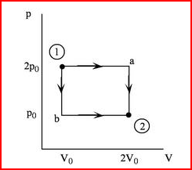
Expansion work (PV work)
Along path a: W = 2p_{0 ­}(2V₀ – V₀) = 2p₀ v₀
Along path b: W = p_{0 ­}(2V₀ – V₀) = p₀ v₀
1
P

Slide 25
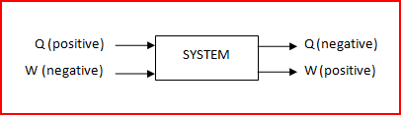
Things to note !!!!
An important component to the solution of any engineering thermodynamic problem is the proper use of units.
Volume (m3)
Pressure (Pa, N/m2),
Temperature (Kelvin)
ALWAYS REMEMBER TO HAVE YOUR UNITS IN THE SI SYSTEM

Slide 26
First Law of Thermodynamics
The first law of thermodynamics is a consequence of the Law of conservation of energy which states that “Energy can be changed from one form to another, but it cannot be created or destroyed. The total amount of energy and matter in the Universe remains constant, merely changing from one form to another”.
This implies that the total energy of the universe is conserved
Note that the first law applies to the system and its surroundings and not the system alone.

Slide 27
Implications of the first law
“Heat and work are mutually convertible but since energy can neither be created nor destroyed, the total energy associated with an energy conversion remains constant”.
“When a system undergoes a thermodynamic cycle then the net heat supplied to the system from the surroundings is equal to net work done by the system on its surroundings.
“No machine can produce energy without corresponding expenditure of energy, i.e., it is impossible to construct a perpetual motion machine of first kind”
There can be no machine which would continuously supply mechanical work without some form of energy disappearing simultaneously. Such a machine is called a perpetual motion machine of the first kind

Slide 28
First Law Equation for Closed Systems
ΔEsystem = Q – W
ΔE = Δ(U+PE+KE) = total energy of the system
Q = heat input to the system
W = work done by the system
For closed systems, no macroscopic transfer of mass,
PE=KE=0
ΔE = Δ(U+PE+KE) = ΔU
Therefore:
ΔU = Q – W

Slide 29
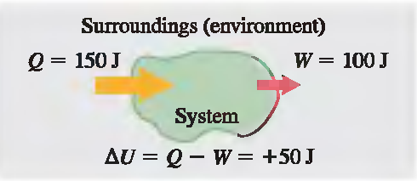
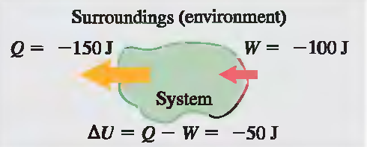
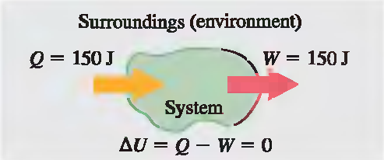
EXAMPLE :

Slide 30
Notes About the First Law
When a system undergoes an infinitesimal change in state in which a small amount of energy dQ is transferred by heat and a small amount of work dW is done, the internal energy changes by a small amount :
(first law of thermodynamics for infinitesimal processes)
Because dQ and dW are inexact differentials

Slide 31
Application of first law to reversible systems
A process is reversible when its direction can be reversed at any point by an infinitesimal change in external conditions.

Slide 32
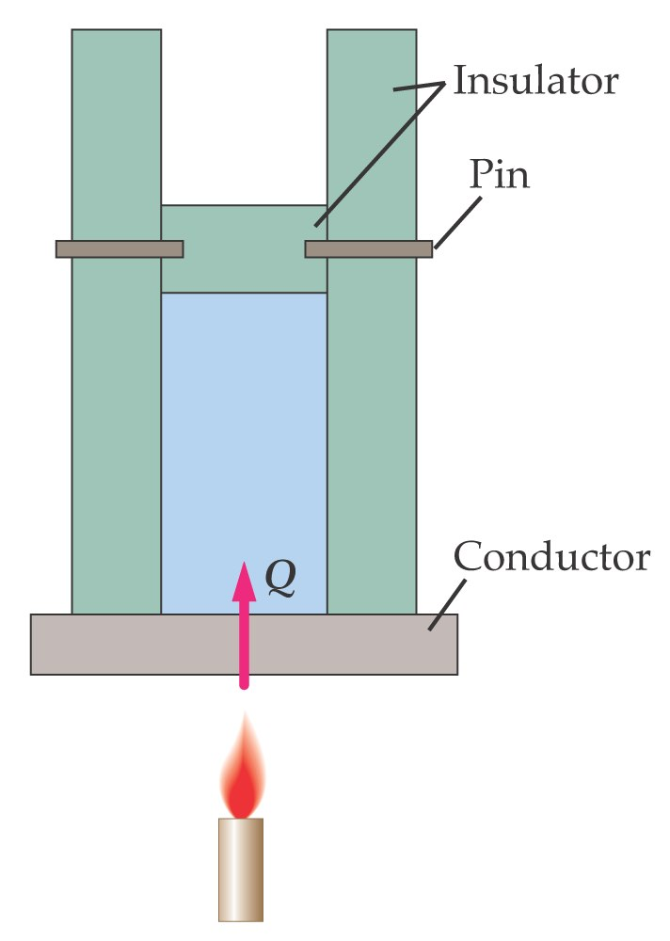
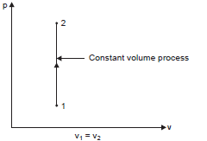
The First Law of Thermodynamics. A reversible constant volume process
If heat is added at constant volume, no work is done, so the heat added equals to the increase in thermal energy
Internal Energy is a state function, i.e. it is not dependent on the process, it only depends of the initial and final temperature

Slide 33
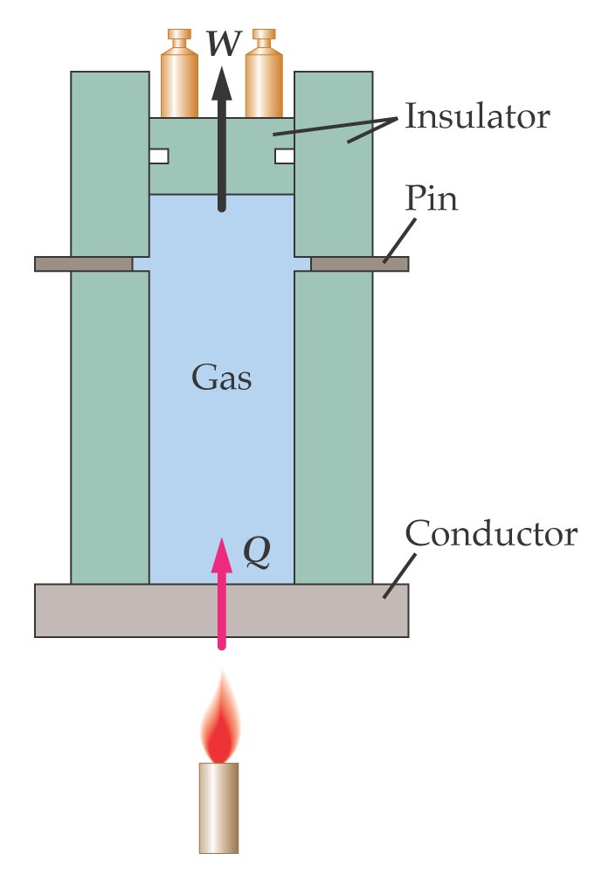
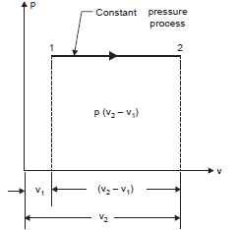
Reversible Constant Pressure Process
If heat is added at constant pressure the heat energy transferred will be used to expand the substance and to increase the internal energy.
Applying the First Law of Thermodynamics
This introduces the concept of enthalpy, Which is the sum of Internal energy and PV work. It is also a state function.

Slide 34
Degrees of Freedom/Phase rule
F = 2-π+N
F is the degrees of freedom
N is the number of chemical species
Π is the number of phases

Slide 35
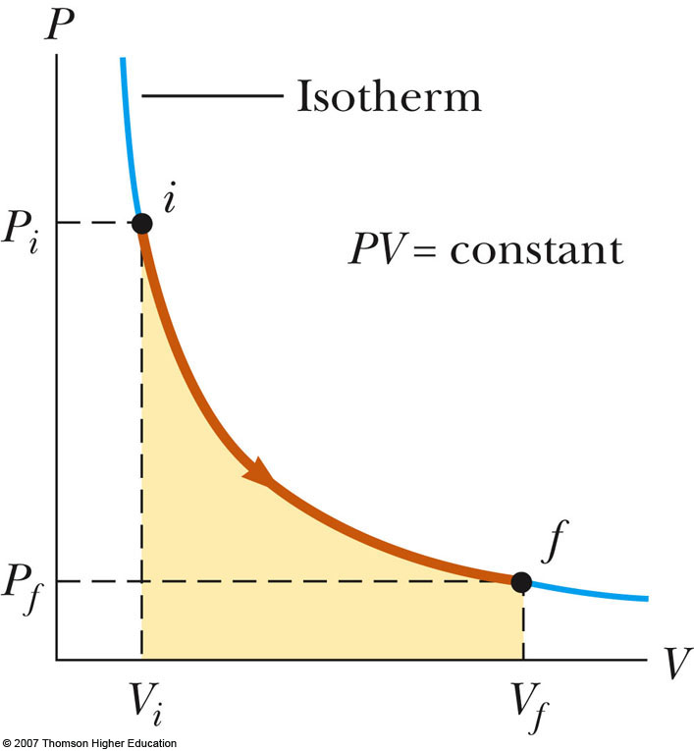
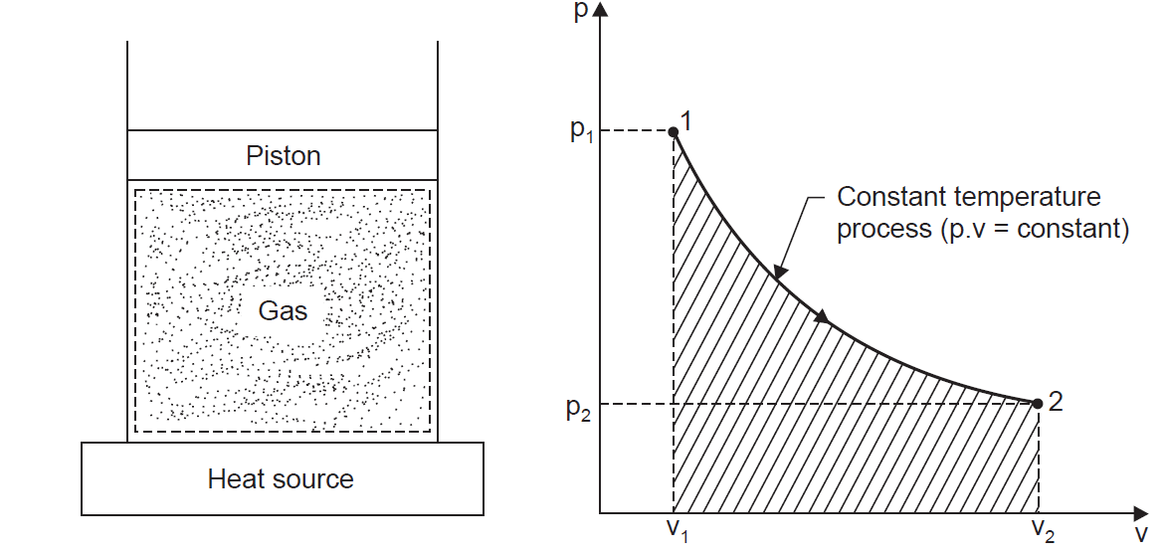
Reversible Constant Temperature Process
A process at a constant temperature is called an isothermal process.
When a working substance in a cylinder behind a piston expands from a high pressure to a low pressure there is a tendency for the temperature to fall. In an isothermal expansion heat must be added continuously in order to keep the temperature at the initial value. Similarly in an isothermal compression heat must be removed from the working substance continuously during the process.

Slide 36
Reversible Constant Temperature Process
Applying the First Law of Thermodynamics

Slide 37
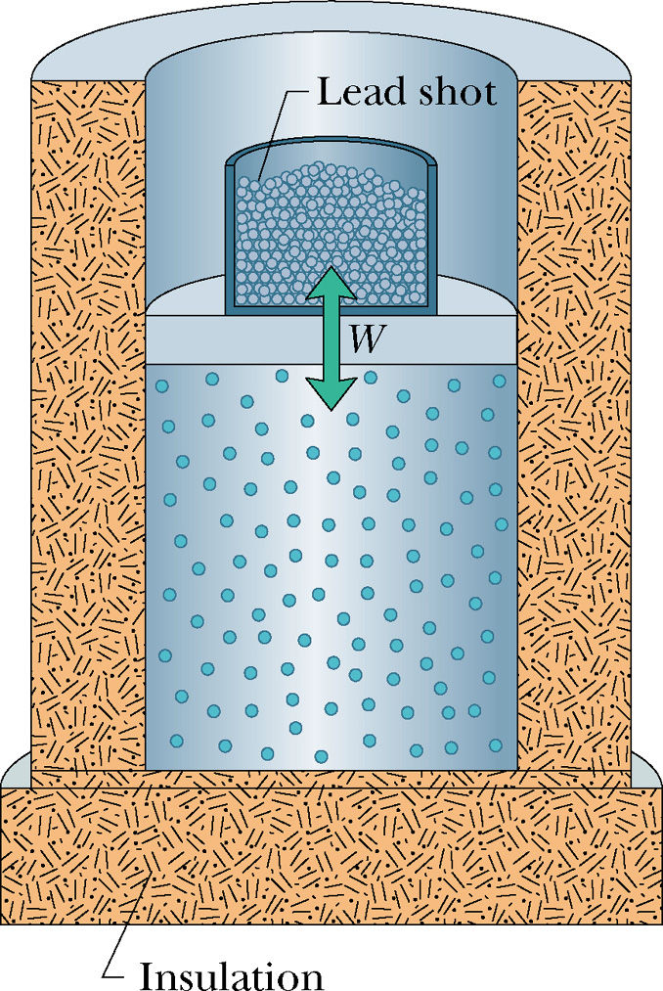
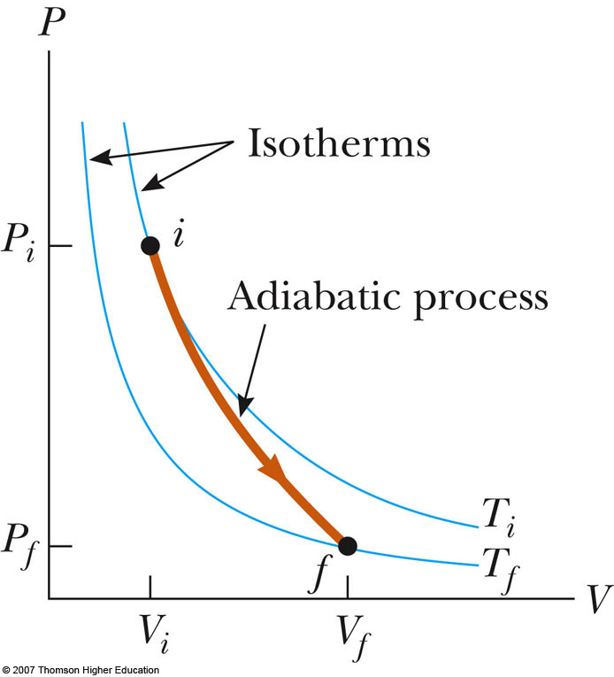
Adiabatic Process (Q=0)
Adiabatic process: no heat transfer between the system and the environment

Slide 38
Work done in a reversible adiabatic process
The work done is given by the shaded area, and this area can be evaluated by integration.

Slide 39
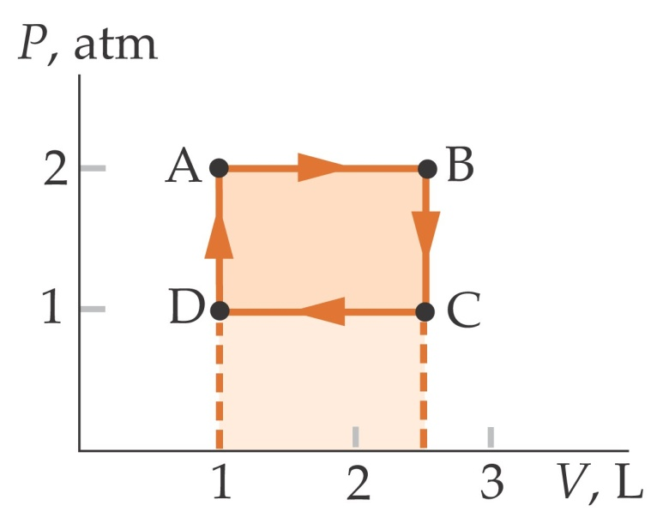
The First Law of Thermodynamics- Home Work
A biatomic ideal gas undergoes a cycle starting at point A (2 atm, 1L). Process from A to B is an expansion at constant pressure until the volume is 2.5 L, after which, it is cooled at constant volume until its pressure is 1 atm. It is then compressed at constant pressure until the volume is again 1L, after which it is heated at constant volume until it is back to its original state. Find (a) the work, heat and change of internal energy in each process (b) the total work done on the gas and the total heat added to it during the cycle.

Slide 40
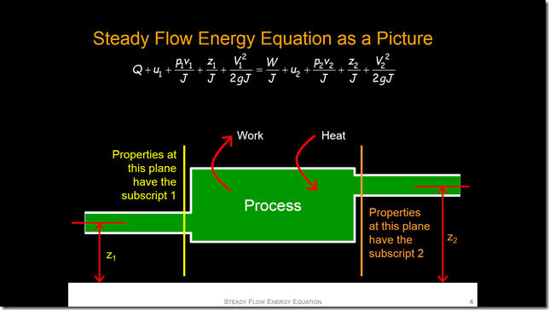
OPEN SYSTEMS (FLOW SYSTEMS)

Slide 41
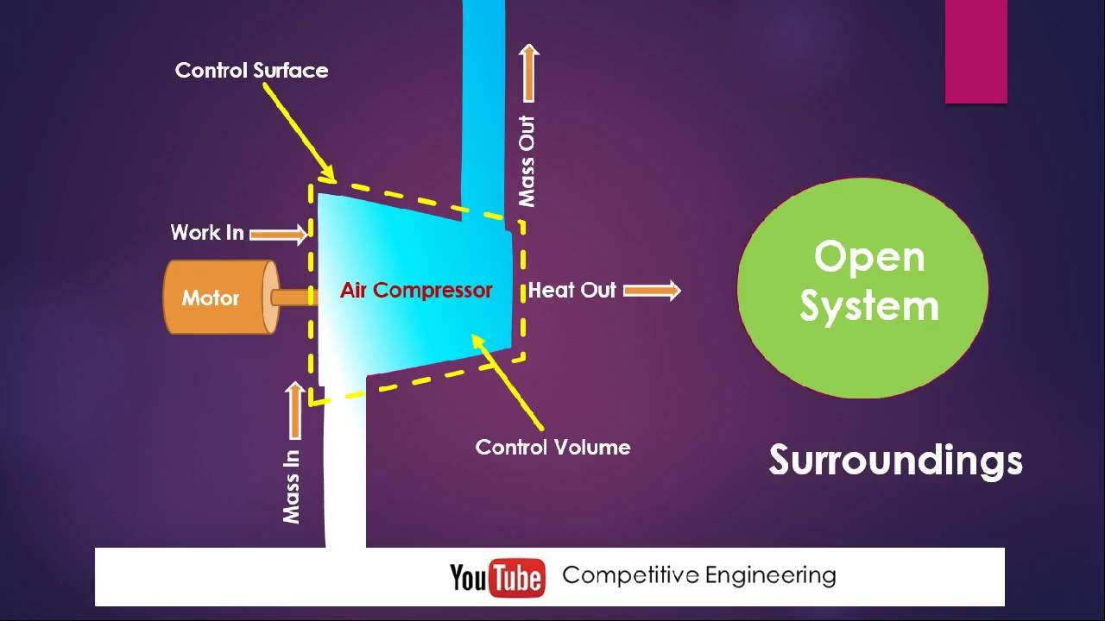
Introduction
The first law of thermodynamics also applies to flow (open) systems.
In open systems, there is transfer of both mass and energy across the boundary of the system.
The medium through which the fluid flows carrying with it mass and energy is called the CONTROL VOLUME (CV) and the boundaries is the CONTROL SURFACE

Slide 42
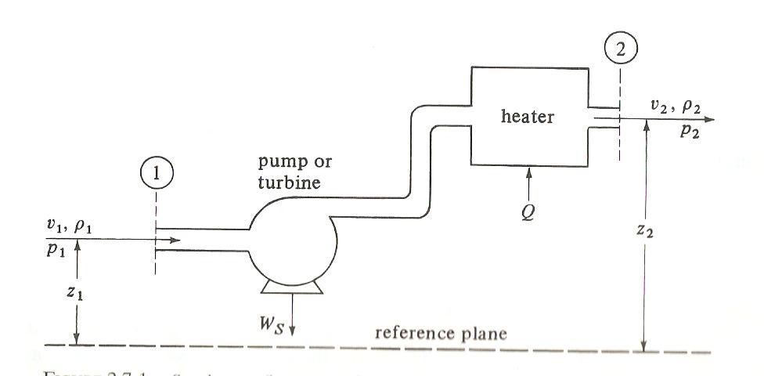
Energy Balance Equation
ΔE = Q – W
The energy E present within a system per unit mass can be classified in three ways as;
Potential energy (zg),
Kinetic energy (c²/2) and
Internal energy (U).

Slide 43
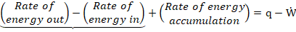
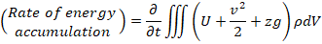
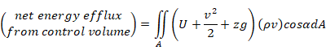
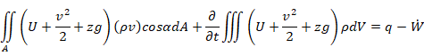
The rate of energy associated with mass flow in a control volume is given as
Net energy efflux from system
The overall energy balance equation is therefore given as

Slide 44
For steady state, normal unidirectional and uniform flow, we have
.
The work (W) which is energy per unit time can be divided into purely shaft work (Ws) and pressure-volume, (pV), that is
Also, the pV term and U term are combined using the definition of enthalpy, H:

Slide 45
Dividing through by m so that the equation is on mass basis,

Slide 46
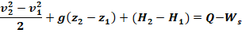
Steady State flow Energy Equation is given as
v = velocity
z = height
H = Enthalpy
Q = Heat transferred
Ws = Shaft work

Slide 47
Summary
At constant volume, no work is done (W = 0), so the heat added equals to the increase in thermal energy
If heat is added at constant pressure the heat energy transferred will be used to expand the substance and to increase the internal energy.
W =PΔV
At constant temperature, there is no change internal energy, ΔU =0
Adiabatic process: no heat transfer between the system and the environment (Q = 0)
For steady state flow systems, the energy equation is given as

Slide 48
Applications of the 1st Law: Examples

Slide 49
VOLUMETRIC PROPERTIES OF PURE FLUIDS

Slide 50
Pure Substances (Introduction)
A pure substance is a system which is
(i) homogeneous in composition,
(ii) homogeneous in chemical aggregation, and
(iii) invariable in chemical aggregation.
“Homogeneous in composition” means that the composition of each part of the system is the same as the composition of every other part
“Homogeneous in chemical aggregation” means that the chemical elements must be combined chemically in the same way in all parts of the system

Slide 51
Invariable in chemical aggregation” means that the state of chemical combination of the system does not change with time
Examples of pure substances include:
Water (solid, liquid, and vapour phases);
Mixture of liquid water and water vapour;
Carbon dioxide, CO₂;
All elements
Oxygen, O₂; and
Mixtures of gases, such as air, as long as there is no change of phase.

Slide 52
PVT Behaviour of pure substance
Pressure, Volume, and Temperature (PVT) are important properties needed for the evaluation of quantities of heat and work required to carry out industrial processes
PVT are related mathematically as equations of state f(P,V,T)=0
PVT relations are used in metering of fluids and the design of vessels and pipelines.

Slide 53
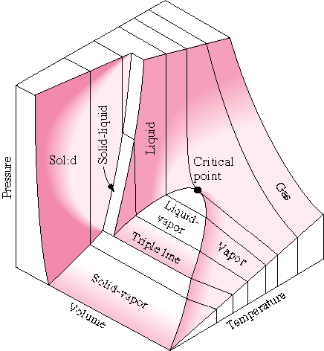
PVT Surface

Slide 54
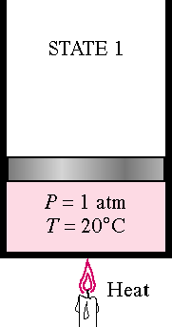
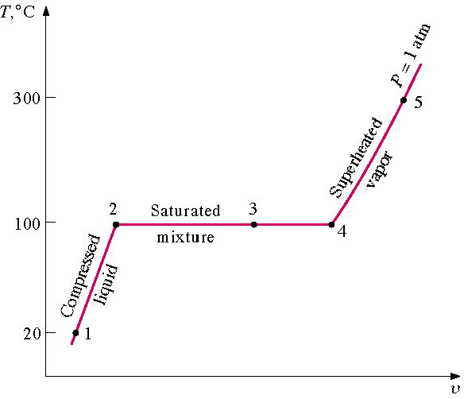
Let us consider 1 kg of liquid water at a temperature of 20°C in a cylinder fitted with a piston, which exerts on the water a constant pressure of one atmosphere (1.0132 bar) as shown in (i).
As the water is heated slowly its temperature rises until the temperature of the liquid water becomes 100°C. During the process of heating, the volume slightly increases as indicated by the line 1-2 on the temperature-specific volume diagram.

Slide 55
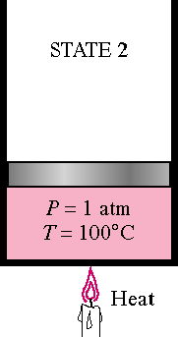
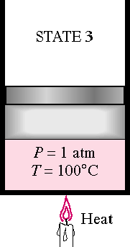
If the heating of the liquid is continued it undergoes a change in phase. This state is described by the line 2-3.
The temperature at which vapourisation takes place at a given pressure is called the saturation temperature and the given pressure is called the saturation pressure.
During the process represented by the line 2-3, the volume increases rapidly.

Slide 56
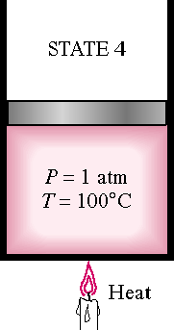
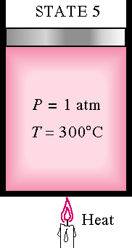
When all the liquid has been evaporated completely and heat is further added, the temperature of the vapour increases. The curve 4-5 describes the process

Slide 57
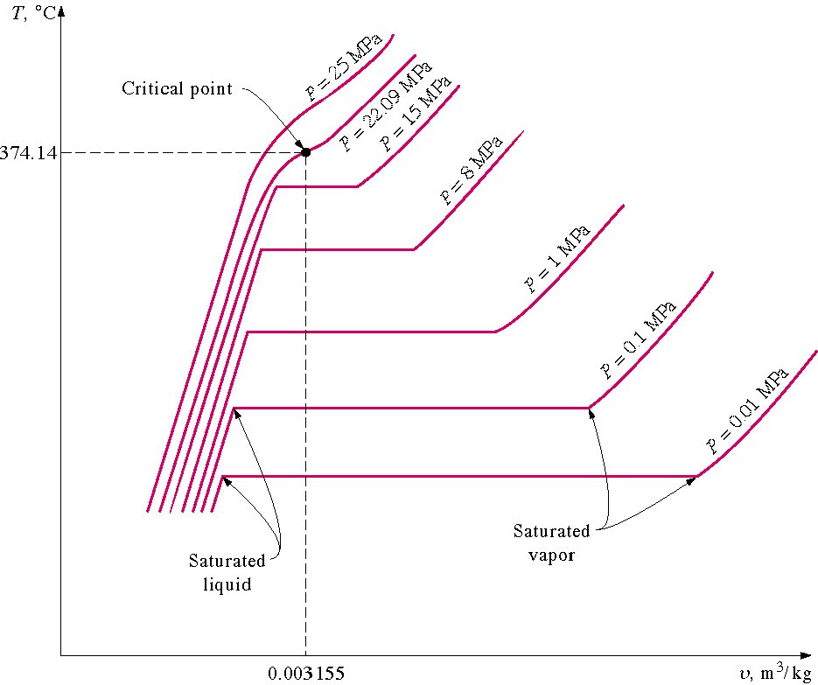
If this process is repeated for a series of constant pressures, we would have a curve like this
If all of the saturated liquid states are connected, the saturated liquid line is established. If all of the saturated vapor states are connected, the saturated vapor line is established. These two lines intersect at the critical point and form what is often called the “steam dome

Slide 58
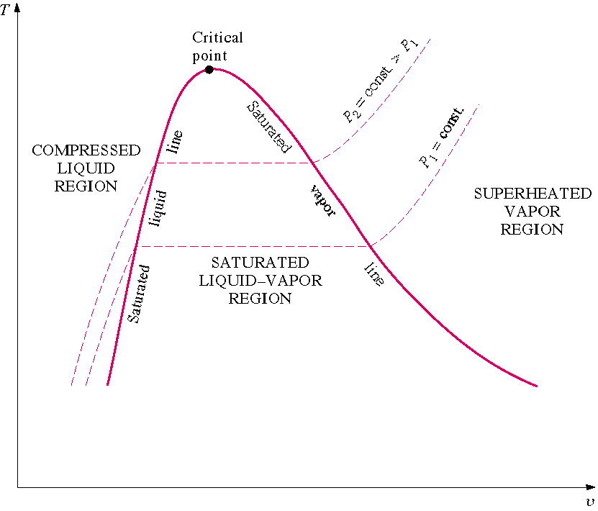
The region to the left of the saturated liquid line and below the critical temperature is called the compressed liquid region.
The region to the right of the saturated vapor line and above the critical temperature is called the superheated region.

Slide 59
When the temperature increases above the saturation temperature the vapour is known as the superheated vapour
The temperature at this state is called the superheated temperature.
The difference between the superheated temperature and the saturation temperature at the given pressure is called the degree of superheat.
The specific volume of the saturated liquid and of the saturated vapour is the same, i.e., vf = vg.
The parameters like temperature, pressure, volume, at the critical state are called critical parameters.

Slide 60
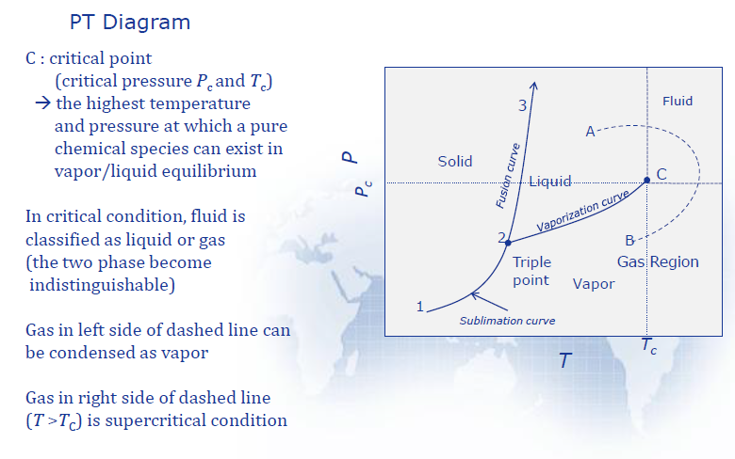

Slide 61
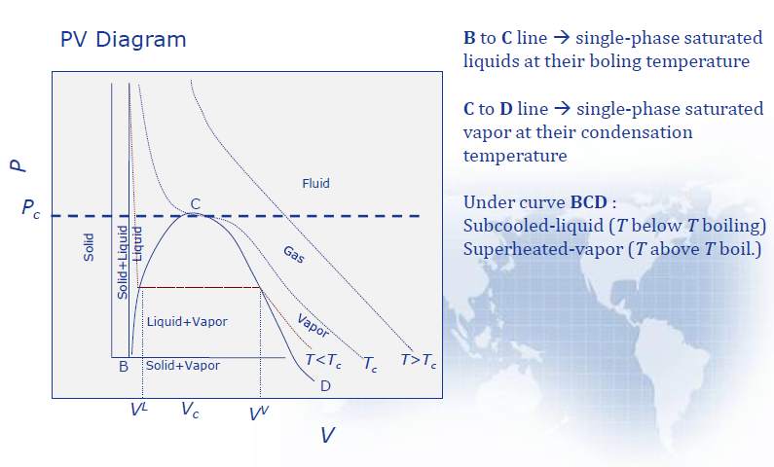

Slide 62
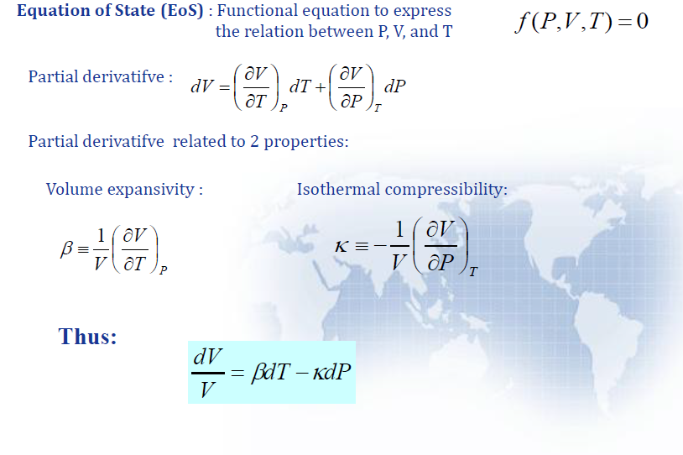
Equation of state (Single phase region)
An equation of state may be solved for any one of the three quantities P, V, or T as a function of the other two. WHY?
For example, if V is considered a function of T and P, then, V=(T,P), and

Slide 63
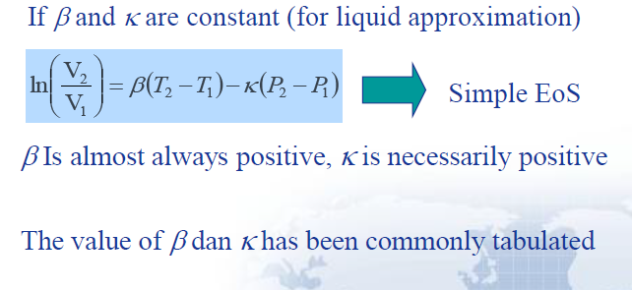
Equation of state (Single phase)

Slide 64
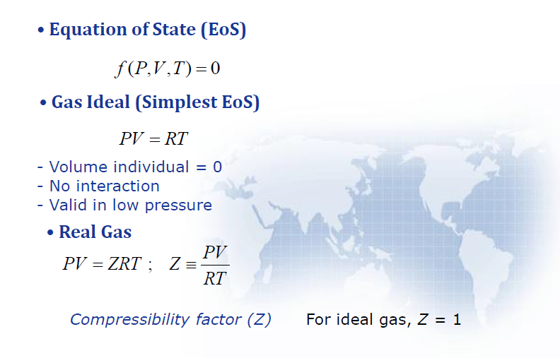
Viral Equation

Slide 65
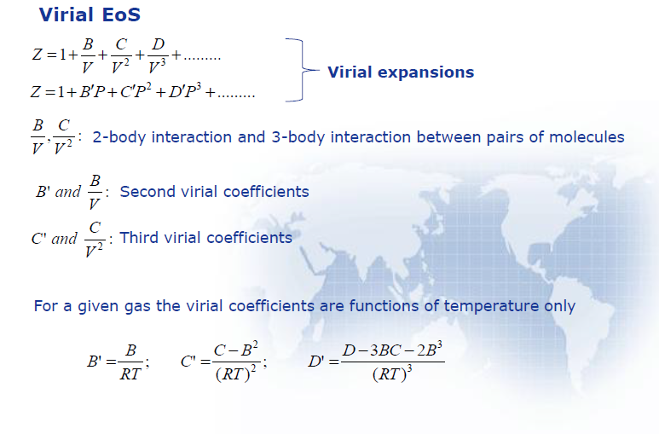

Slide 66
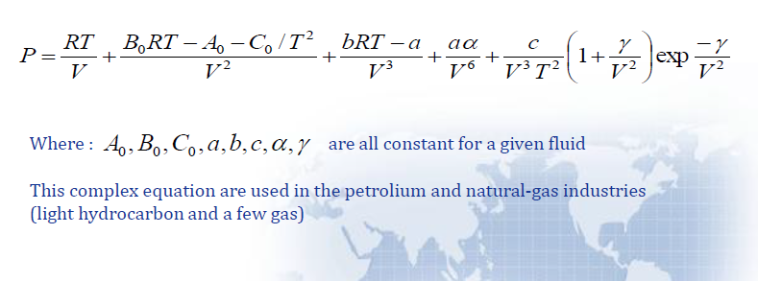
Rubin/Webb Equation

Slide 67
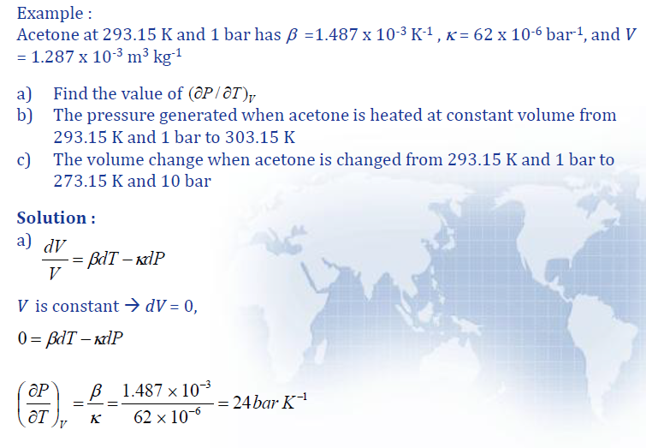

Slide 68
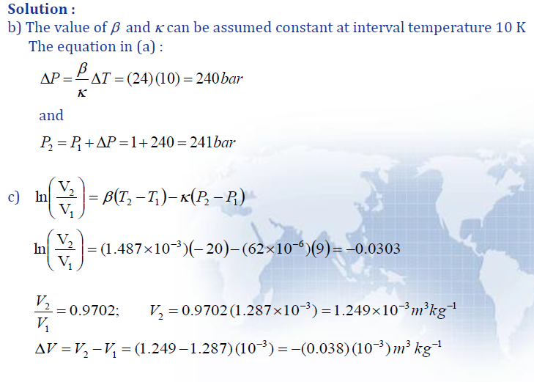

Slide 69
Second Law of Thermodynamics

Slide 70
Limitations of the first law
The first law tells us that energy is conserved and can flow from a system as work or heat but it places no limit on the total energy of a system which can be converted to work.
It establishes equivalence between the quantity of heat used and the mechanical work but does not specify the conditions under which conversion of heat into work is possible.
It does not also tell us the direction in which heat transfer can take place

Slide 71
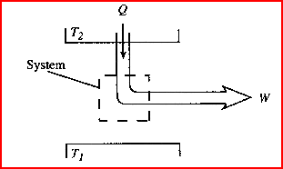
Statements of the second law
Statement 1: It is impossible by a cyclic process to convert the heat absorbed by a system completely into work done by the system (Kelvin- Planck statement)
Impossible (Kelvin- Planck)

Slide 72
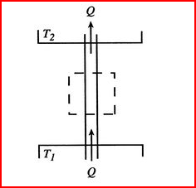
Statement 2: No process is possible which consist solely in the transfer of heat from lower temperature level to a higher one (Clausius statement)
Note that the first law of thermodynamics is not violated if heat flows from a low temperature to a high temperature without the expenditure of work.
For T₁ < T₂ , this is impossible (Classius)

Slide 73
Some Definitions
The second law thus tells us that we cannot get work from a single reservoir only.
A process will not occur unless it satisfies both the first and the second laws of thermodynamics.
To express the second law in a workable form, we need to understand certain terminologies

Slide 74
Heat (Thermal) Reservoir
A heat reservoir is a sufficiently large system in stable equilibrium to which and from which finite amounts of heat can be transferred without any change in its temperature.
A high temperature heat reservoir from which heat is transferred is sometimes called a heat source. Eg of heat source is a constant temperature furnace.
A low temperature heat reservoir to which heat is transferred is sometimes called a heat sink. Eg of heat sink is the sea/river/atmoshere.

Slide 75
Work (Mechanical energy) Reservoir
A work reservoir is a sufficiently large system in stable equilibrium to which and from which finite amounts of work can be transferred adiabatically without any change in its pressure.

Slide 76



Heat Engines
A heat engine is a device that converts heat into work. A classic example is the steam engine. Fuel heats the water; the vapor expands and does work against the piston; the vapor condenses back into water again and the cycle repeats.
All heat engines have:
- working substance
- high-temperature reservoir
- low-temperature reservoir
- cyclical engine

Slide 77

Thermal Efficiency,
The thermal efficiency is the index of performance of a work-producing device or a heat engine and is defined by the ratio of the net work output (the desired result) to the heat input (the costs to obtain the desired result).
For a heat engine the desired result is the net work done and the input is the heat supplied to make the cycle operate. The thermal efficiency is always less than 1 or less than 100 percent.

Slide 78
where
Now apply the first law to the cyclic heat engine.
0 (Cyclic)

Slide 79

The cycle thermal efficiency may be written as
Cyclic devices such as heat engines, refrigerators, and heat pumps often operate between a high-temperature reservoir at temperature T_{H} and a low-temperature reservoir at temperature T_{L}.

Slide 80
The thermal efficiency of the above device becomes
Example
A steam power plant produces 50 MW of net work while burning fuel to produce 150 MW of heat energy at the high temperature. Determine the cycle thermal efficiency and the heat rejected by the cycle to the surroundings.

Slide 81
Heat Pump
A heat pump is a thermodynamic system operating in a thermodynamic cycle that removes heat from a low-temperature body and delivers heat to a high-temperature body. To accomplish this energy transfer, the heat pump receives external energy in the form of work or heat from the surroundings.
While the name “heat pump” is the thermodynamic term used to describe a cyclic device that allows the transfer of heat energy from a low temperature to a higher temperature, we use the terms “refrigerator” and “heat pump” to apply to particular devices.
Here a refrigerator is a device that operates on a thermodynamic cycle and extracts heat from a low-temperature medium.
The heat pump also operates on a thermodynamic cycle but rejects heat to the high-temperature medium.
The following figure illustrates a refrigerator as a heat pump operating in a thermodynamic cycle.

Slide 82

Coefficient of Performance, COP
The index of performance of a refrigerator or heat pump is expressed in terms of the coefficient of performance, COP, the ratio of desired result to input. This measure of performance may be larger than 1, and we want the COP to be as large as possible.

Slide 83

For the heat pump acting like a refrigerator or an air conditioner, the primary function of the device is the transfer of heat from the low- temperature system.
For the refrigerator the desired result is the heat supplied at the low temperature and the input is the net work into the device to make the cycle operate.

Slide 84
Now apply the first law to the cyclic refrigerator.
and the coefficient of performance becomes
For the device acting like a “heat pump,” the primary function of the device is the transfer of heat to the high-temperature system (QH). The coefficient of performance for a heat pump is
Note, under the same operating conditions the COP_{HP} and COP_{R} are related by

Slide 85


Slide 86
PMM
Any device that violates the first or second law of thermodynamics is called a perpetual-motion machine.
If the device violates the first law, it is a perpetual-motion machine of the first kind.
If the device violates the second law, it is a perpetual-motion machine of the second kind.

Slide 87



PMM2

Slide 88
The Carnot Cycle
The Carnot cycle is best known reversible cycle; it was proposed by French soldier Sadi Carnot in 1824.
The Carnot cycle is the most efficient cycle possible for converting a given amount of thermal energy into work.
A Carnot heat engine is a hypothetical engine that operates on the reversible Carnot cycle.
A Carnot cycle has four processes.
There are two adiabatic reversible paths and two isothermal reversible paths.

Slide 89


The Carnot Cycle
Process 1-2:Reversible isothermal heat addition at high temperature, T_{H} > T_{L}, to the working fluid in a piston-cylinder device that does some boundary work.
Process 2-3:Reversible adiabatic expansion during which the system does work as the working fluid temperature decreases from T_{H} to T_{L}.
Process 3-4:The system is brought in contact with a heat reservoir at T_{L} < T_{H} and a reversible isothermal heat exchange takes place while work of compression is done on the system.
Process 4-1:A reversible adiabatic compression process increases the working fluid temperature from T_{L} to T_{H}

Slide 90


You may have observed that power cycles operate in the clockwise direction when plotted on a process diagram. The Carnot cycle may be reversed, in which it operates as a refrigerator. The refrigeration cycle operates in the counterclockwise direction.

Slide 91
Carnot Principles
The second law of thermodynamics puts limits on the operation of cyclic devices as expressed by the Kelvin-Planck and Clausius statements. A heat engine cannot operate by exchanging heat with a single heat reservoir, and a refrigerator cannot operate without net work input from an external source.
Consider heat engines operating between two fixed temperature reservoirs at T_{H} > T_{L}. We draw two conclusions about the thermal efficiency of reversible and irreversible heat engines, known as the Carnot principles.
(a)The efficiency of an irreversible heat engine is always less than the efficiency of a reversible one operating between the same two reservoirs.
(b) The efficiencies of all reversible heat engines operating between the same two constant-temperature heat reservoirs have the same efficiency.

Slide 92


The thermal efficiencies of actual and reversible heat engines operating between the same temperature limits compare as follows:
The coefficients of performance of actual and reversible (such as Carnot) refrigerators operating between the same temperature limits compare as follows:

Slide 93

Efficiency of a reversible Heat Engine
The efficiency of a reversible heat engine in which heat is received solely at T1 is found to be
From the above expression, it may be noted that as T2 decreases and T1 increases, The efficiency of the reversible cycle increases.
Since η is always less than unity, T2 is always greater than zero and + ve.

Slide 94

COP for reversible refrigerator

Slide 95
Can the Carnot Cycle be performed in practice?

Slide 96
Entropy: A measure of Disorder
The second law of thermodynamics leads to the definition of a new property called entropy.
We will soon see that this property is quantitative measure of microscopic disorder for a system.
Entropy is a measure of energy that is no longer available to perform useful work within the current environment.

Slide 97

To obtain the working definition of entropy and, thus, the second law, let's derive the Clausius inequality.
Consider a heat reservoir giving up heat to a reversible heat engine, which in turn gives up heat to a piston-cylinder device as shown below.

Slide 98
We apply the first law on an incremental basis to the combined system composed of the heat engine and the system.
where E_{c} is the energy of the combined system. Let W_{c} be the work done by the combined system. Then the first law becomes
If we assume that the engine is totally reversible (Carnot cycle), then
The total net work done by the combined system becomes

Slide 99





Now the total work done is found by taking the cyclic integral of the incremental work.
If the system, as well as the heat engine, is required to undergo a cycle, then
and the total net work becomes
If W_{c} is positive, we have a cyclic device exchanging energy with a single heat reservoir and producing an equivalent amount of work; thus, the Kelvin-Planck statement of the second law is violated. But W_{c} can be zero (no work done) or negative (work is done on the combined system) and not violate the Kelvin-Planck statement of the second law. Therefore, since T_{R} > 0 (absolute temperature), we conclude:
or

Slide 100

Here Q is the net heat added to the system, Q_{net}.
This equation is called the Clausius inequality.
The equality holds for the reversible process and,
The inequality holds for the irreversible process.

Slide 101
Definition of Entropy
For a reversible cyclic process, the Clausius inequality is ZERO.
This suggests that the quantity (δQ_{net}/T) is independent of the path and is a function of the initial and final states of the system and must be a property of the system just as INTERNAL ENERGY.
This property is known as the ENTROPY.
The entropy change occurring during a process is related to the heat transfer and the temperature of the system. The entropy is given the symbol S (kJ/K), and the specific entropy is s (kJ/kg⋅K).

Slide 102
In general the entropy change during a process is defined as
where = holds for the internally reversible process
> holds for the irreversible process

Slide 103


Definition of Second Law of Thermodynamics
Now consider an isolated system composed of several subsystems exchanging energy among themselves. Since the isolated system has no energy transfer across its system boundary, the heat transfer across the system boundary is zero.
Applying the definition of entropy to the isolated system
The total entropy change for the isolated system is

Slide 104

This equation is the working definition of the second law of thermodynamics. The second law, known as the principle of increase of entropy, is stated as
The total entropy change of an isolated system during a process always increases or, in the limiting case of a reversible process, remains constant. No process is possible for which the total entropy decreases.
Now consider a general system exchanging mass as well as energy with its surroundings.
where = holds for the totally reversible process
> holds for the irreversible process

Slide 105

Since all natural processes are irreversible, the entropy is increasing continually! This means systems are constantly in a state of increase disorder or randomization until the systems reaches a stable equilibrium, where it attains a state of maximum disorder.
Entropy change is caused by heat transfer and irreversibility. Heat transfer to a system increases the entropy, and heat transfer from a system decreases it. The effect of irreversibility is always to increase the entropy.
The increase in entropy principle can be summarized as follows:

Slide 106
Some Remarks about Entropy
Processes can occur in a certain direction only, not in just any direction, such that S_{gen}≥0.
Entropy is a non-conserved property, and there is no such thing as the conservation of entropy principle. The entropy of the universe is continuously increasing.
The performance of engineering systems is degraded by the presence of irreversibilities, and entropy generation is a measure of the magnitudes of the irreversibilities present during that process.

Slide 107


Temperature-Entropy Diagram (T-S Curve)
2
T
Area under the process curve is the heat transfer.
Q_{net}
1
ds
s
In the above figure, the heat transfer in an internally reversible process is shown as the area under the process curve plotted on the T-S diagram.

Slide 108
Entropy change for closed system

Slide 109


Entropy Change: Heating at Constant Volume
Let 1 kg of gas be heated at constant volume and let the change in entropy and absolute temperature be from s1 to s2 and T1 to T2 respectively.

Slide 110


Heating a Gas at Constant Pressure
Let 1 kg of gas be heated at constant pressure, so that its absolute temperature changes from T1 to T2 and entropy s1 to s2.

Slide 111

Isothermal, Reversible Process
HOME WORK!!!!!!

Slide 112

Adiabatic, Reversible (Isentropic) Process
For an adiabatic process, one in which there is no heat transfer, the entropy change is
If the process is adiabatic and reversible, the equality holds and the entropy change is
or on a per unit mass basis

Slide 113
Third Law of Thermodynamics
The third law of thermodynamics states that the entropy of a pure crystalline substance at absolute zero temperature is zero. This law provides an absolute reference point for the determination of entropy. The entropy determined relative to this point is called absolute entropy.
Entropy as a Property
Entropy is a property, and it can be expressed in terms of more familiar properties (P,v,T) through the Tds relations. These relations come from the analysis of a reversible closed system that does boundary work and has heat added. Writing the first law for the closed system in differential form on a per unit mass basis
δQ_{int rev}
δW_{int rev, out}
System used to find expressions for ds

Slide 114
On a unit mass basis we obtain the first Tds equation, or Gibbs equation, as
Recall that the enthalpy is related to the internal energy by h = u + Pv. Using this relation in the above equation, the second Tds equation is
These last two relations have many uses in thermodynamics and serve as the starting point in developing entropy-change relations for processes. The successful use of Tds relations depends on the availability of property relations. Such relations do not exist in an easily used form for a general pure substance but are available for incompressible substances (liquids, solids) and ideal gases. So, for the general pure substance, such as water and the refrigerants, we must resort to property tables to find values of entropy and entropy changes.

Slide 115

The enthalpy-entropy diagram for water is shown below.
Shown above are the temperature-entropy and enthalpy-entropy diagrams for water. The h-s diagram, called the Mollier diagram, is a useful aid in solving steam power plant problems where heat transfer and work may be expressed as enthalpy changes for steady-flow constant pressure and isentropic processes, respectively.

Slide 116
Summary of Second Law (Highlights)
Clausius statement :
“It is impossible for a self-acting machine working in a cyclic process, unaided by any external agency, to convey heat from a body at a lower temperature to a body at a higher temperature.”
Kelvin-Planck statement :
“It is impossible to construct an engine, which while operating in a cycle produces no other effect except to extract heat from a single reservoir and do equivalent amount of work”
Although above statements of second law of thermodynamic appear to be different, they are really equivalent in the sense that violation of either statement implies violation of other.
Perpetual motion machine of second kind (PMM2) is that imaginary machine which would continuously absorb heat from a single thermal reservoir and convert this heat completely into work. The efficiency of such a machine would be 100%.

Slide 117

Entropy’ is a function of a quantity of heat which shows the possibility of conversion of that heat into work.
The third law of thermodynamics states that the entropy of a pure crystalline substance at absolute zero temperature is zero.

